Slide 1


Slide 2

Notes:
In Australia, bowel cancer is the second most common cancer in both
men and women.
•• Bowel cancer often develops without any early signs or symptoms –
you can have bowel cancer without knowing it.
•• Bowel cancer is one of the most treatable types of cancer if found
early. It can be successfully treated in 9 out of 10 cases if detected in
the early stages.
•• There is a simple, free test you can do at home to find bowel cancer
early, which could save your life.

Slide 3
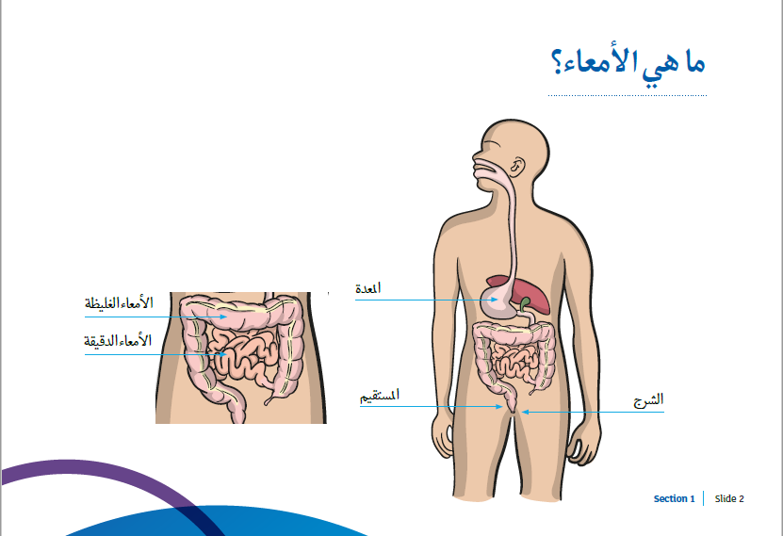
Notes:
The bowel connects your stomach to your rectum where waste material
(faeces) is stored until passed out from the anus.
•• The bowel has 3 main parts:
-- The small bowel – takes in the nutrients (goodness) from our food.
-- The large bowel (colon) – takes in water and salt.
-- The rectum – stores the waste material (faeces).
•• The bowel helps digest the food we eat.
•• Digestion is when our food and drink are broken down into nutrients
for our body to use for energy and to build and support our cells.

Slide 4
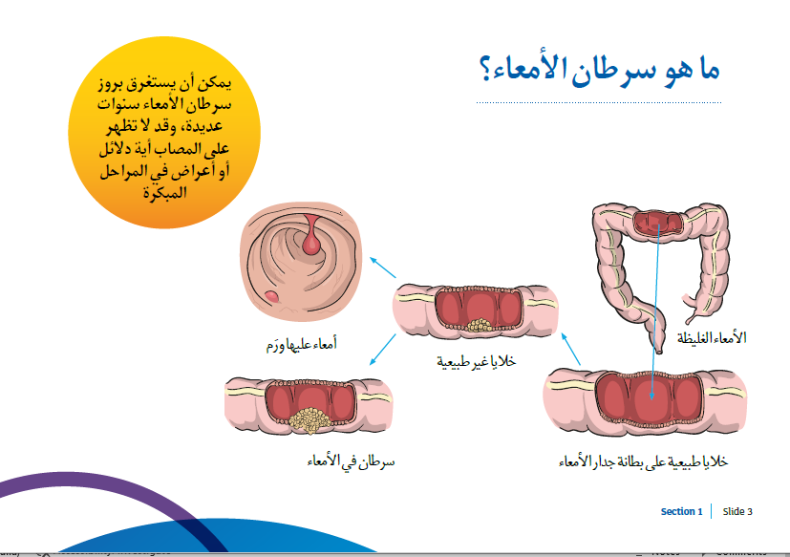
Notes:
Bowel cancer can take many years to develop and may not show any signs or
symptoms in the early stages.
How does bowel cancer develop?
•• The bowel is made up of cells.
•• For our bowel to stay healthy, old cells are constantly replaced by new cells.
•• Sometimes things can go wrong during this process.
•• Unlike normal cells, cancer cells don’t stop growing. So the cells keep
doubling, forming a lump that continues to grow.
•• In the bowel, some of these lumps can grow into polyps.
•• Polyps are small growths on the lining of the bowel that look a bit like a
cherry on a stalk.
•• Many polyps are harmless, but some can grow into cancer.
•• If polyps are removed, the risk of bowel cancer is reduced.
•• If cancerous polyps are not found and removed early, there is a risk that they
could grow and eventually spread cancer cells to other parts of the body.

Slide 5

Notes:
The biggest bowel cancer risk factor for both men and women is being
aged 50 years and over. 9 out of 10 bowel cancers are diagnosed in
people over the age of 50.
The risk of bowel cancer is also higher for people who have:
•• A strong family history. This means having a close family member
(such as a parent, sibling or child) who developed bowel cancer under
the age of 55, or having more than one close family member who
developed bowel cancer at any age.
Note: Most (8 out of 10) people who get bowel cancer have no family
history of the disease.
•• Bowel diseases which cause ongoing inflammation of the bowel.
•• Type 2 diabetes.
•• Unhealthy lifestyle behaviours (shown in the next slide).

Slide 6

Notes:
You can reduce your risk of bowel cancer by making healthy lifestyle
choices.
Nearly half of all bowel cancers in Australia can be attributed to lifestyle
factors, including:
•• Smoking.
•• What we eat – i.e. eating foods which are highly processed (like white
bread, biscuits and chips), eating red meat and processed meats (like
bacon, ham and salami), and not having enough fibre (fibre is found in
fruit and vegetables).
•• Drinking alcohol.
•• Being physically inactive.
•• Being overweight or obese.

Slide 7
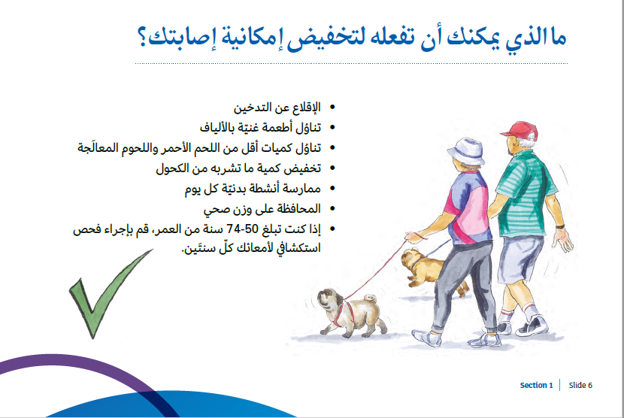
Notes:
You can reduce your risk of bowel cancer by making healthy changes to your
lifestyle.
Here are some changes you can make to reduce your risk:
•• Quit smoking.
•• Eat a healthy diet of wholegrain, wholemeal and high fibre foods such as
wholemeal bread, brown rice and porridge. Aim for 2 serves of fruit and 5
serves of vegetables each day.
•• Eat less red meat and avoid processed meats (like bacon, ham and salami),
as well as highly processed foods like white bread, biscuits and chips.
•• Avoid alcohol or reduce the amount you drink.
•• Be physically active every day.
•• Maintain a healthy body weight.
•• If you are aged 50-74, do a bowel screening test every 2 years.

Slide 8
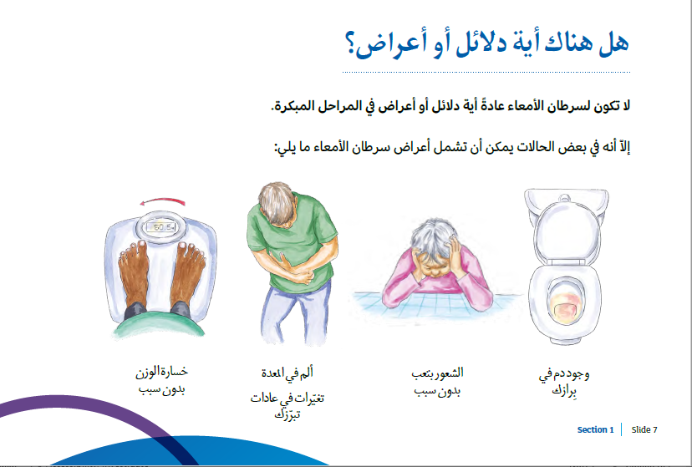
Notes:
Bowel cancer usually has no signs or symptoms in the early stages. This
is why regular bowel screening is essential, even if you feel well and
everything seems normal.
However, in some cases signs and symptoms of bowel cancer can include:
•• Blood in your bowel movements - there might be blood on the toilet paper or
in the water after a bowel movement.
•• Unexplained tiredness.
•• Stomach pain.
•• A sudden and persistent change in toilet habits. For example a person might
notice they have looser bowel movements (diarrhoea) or are straining to
have a bowel movement (constipation).
•• Unexplained weight loss.
•• An iron deficiency (anaemia).
If you have any of these symptoms, it does not necessarily mean that you
have bowel cancer, but you should follow up with your doctor.

Slide 9
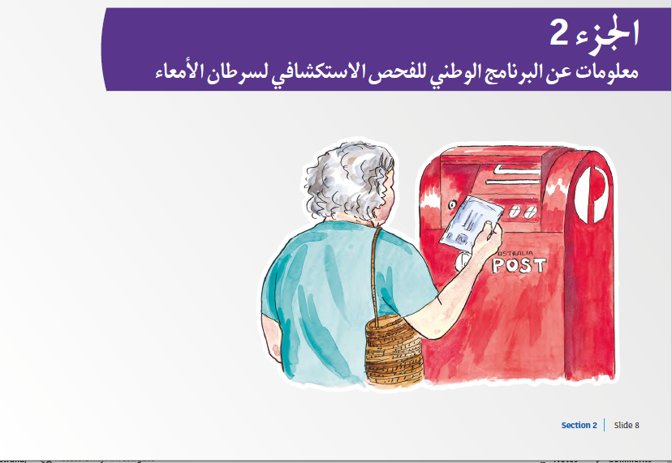
Notes:
The National Bowel Cancer Screening Program (the Program) mails out
free kits to eligible people aged 50 to 74 for them to complete at home.
•• Medicare provides the Program with a list of people who are aged
50 to 74, so that kits can be mailed out to them every 2 years close to
their birthday.
•• The National Bowel Cancer Screening Program has been funded by
the Australian Government since 2006. The Program aims to reduce
deaths from bowel cancer through early detection.
•• It is one of the most life-saving public health programs in Australia.

Slide 10

Notes:
A bowel screening test can detect changes in the bowel long before
you would notice any signs or symptoms. If you’re aged 50 to 74 and
eligible you will be sent a free test kit from the National Bowel Cancer
Screening Program every 2 years.
•• A bowel screening test involves taking 2 small stool samples in the
privacy of your own home and posting them away for testing.
•• Bowel cancer or polyps can grow on the inside of the bowel and can
leak tiny amounts of blood which are invisible to the eye.
•• The test is looking for any tiny traces of blood in the stool samples
which might indicate a growth inside the bowel.
•• If found in the early stages, 9 out of 10 bowel cancers can be
successfully treated.

Slide 11

Notes:
Nearly all men and women aged 50-74 should do a test every 2 years.
•• However, if you have any signs or symptoms of bowel cancer or a
strong family history (see slide 4 for more detail) talk to your doctor as
soon as possible as you may need to have some other tests.
•• You also may not need to do the test if you have had a colonoscopy in
the last 2 years or are seeing your doctor about bowel problems.

Slide 12
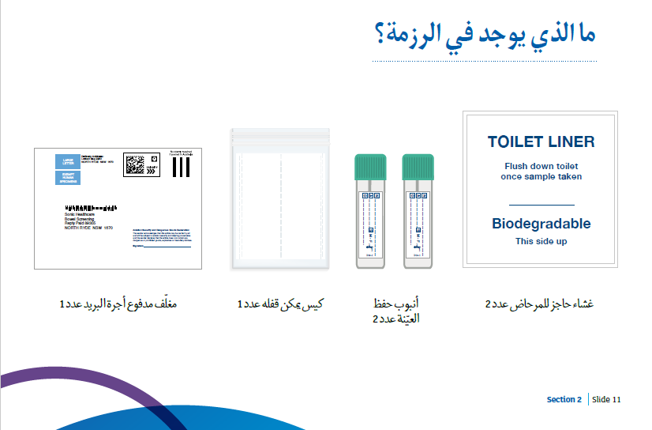
Notes:
In your kit you will find everything you need to do the test:
•• 2 toilet liners (these are to catch your bowel movement so you can
take 2 small samples). These are biodegradable and can be flushed
down the toilet when you are done.
•• 2 green top collection tubes with collection sticks inside (these tubes
are to store your 2 samples and contain a preserving agent).
•• 1 ziplock bag with 2 compartments (this is to store your collection
tubes and further protect them from touching anything whilst being
stored at home).
•• 1 reply paid envelope (this is used to post your samples back to the
Program’s pathology lab).

Slide 13

Notes:
The test looks for blood in your bowel movement, so delay doing the test if:
•• You have haemorrhoids which are bleeding. Wait until your
haemorrhoids calm down before you do the test.
•• You have your menstrual period. Wait for 3 days after your period before
doing the test.
•• There is blood in your urine or blood in the toilet bowl. If this happens,
see your doctor.
•• You are having treatment for bowel problems.
•• You are booked for a colonoscopy in the next few weeks or if you have
had a colonoscopy in the last 2 years.
Note: There is no need to change your normal diet or stop taking any
regular prescribed medications before doing the test.

Slide 14
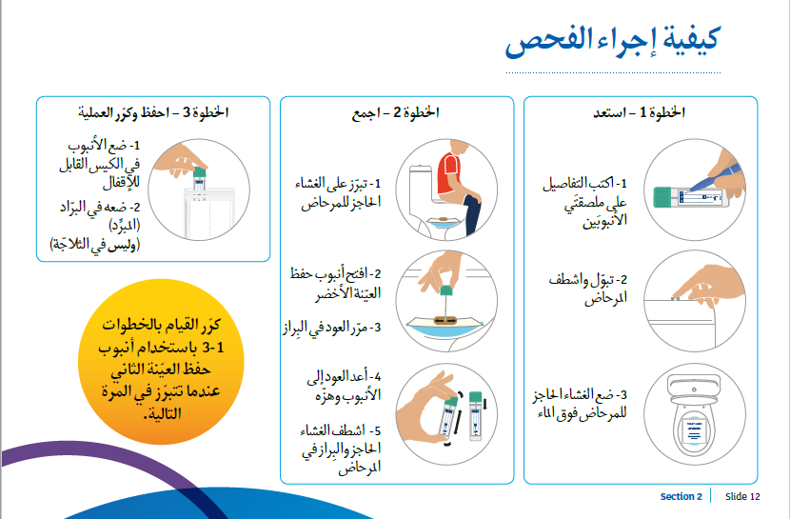
Notes:
STEP 1 – Prepare
1. On one of the tube labels, write your name, date of birth and date the sample was
taken.
2. Before collecting your sample, empty your bladder (do a wee) and flush the toilet.
3. Put the toilet liner over the water in the toilet bowl. The writing should be facing up.
If the toilet liner sinks, it’s still ok to take the sample, or you can request a new kit.
STEP 2 – Collect
1. Do your bowel movement onto the toilet liner.
2. Open the collection tube by twisting the green cap.
3. Scrape the tip of the stick over different areas of the surface of the bowel movement.
The sample only needs to be tiny – smaller than a grain of rice.
4. Put the stick back into the collection tube and click the lid shut. Shake the tube up and
down several times. Do not remove the stick again.
5. Flush the toilet liner and bowel movement down the toilet. Wash your hands.
STEP 3 – Store and repeat
1. Place the tube into one compartment of the ziplock bag.
2. Put the sample in the fridge (do not freeze).
Repeat Steps 1 – 3 with the second collection tube when you have another bowel
movement (on the same day, the next day, or as soon as you can).
Turn over for Step 4.

Slide 15
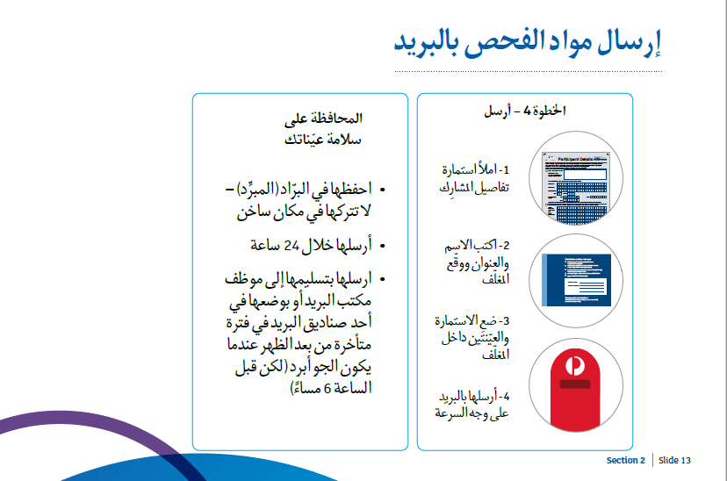
Notes:
STEP 4 – Send
1. Complete the Participant Details form.
2. Write your name and address on the back of the Reply Paid envelope and sign the
front.
3. Put the Participant Details form and the 2 collection tubes (in the sealed ziplock bag)
into the Reply Paid envelope and seal it.
4. Take the envelope to a post office within 24 hours, or put the envelope in a mail box
in the late afternoon (before 6pm) using an Australia Post mail box.
Keeping your samples safe
The samples are sensitive to heat and time.
•• The samples must remain cool, so do not leave them in a hot place such as a car.
•• Store samples in the fridge but never freeze them.
•• Post samples within 24hrs of taking your second sample.
•• Post at the post office or, if you need to use a post box, do it in the late afternoon
when it is cooler (but before 6pm mail collection)
Consider using a sample bowel screening test kit to demonstrate how to do the test.

Slide 16
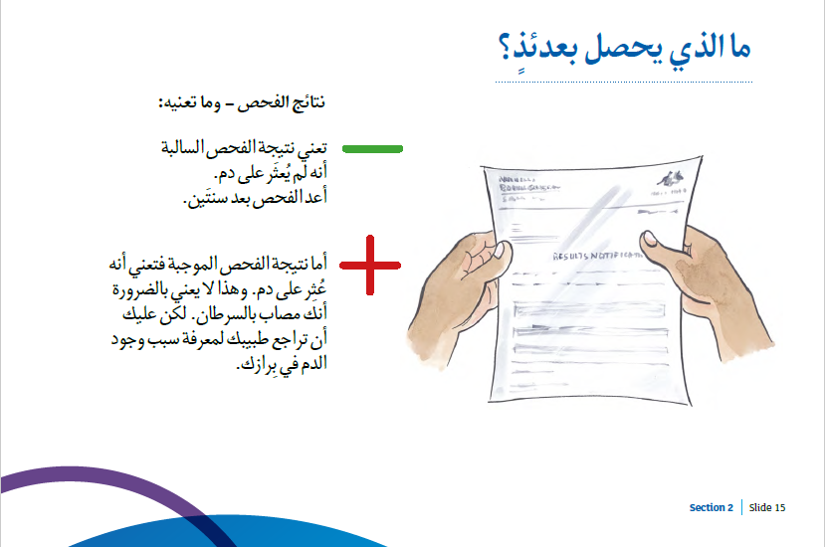
Notes:
You will receive a results notification letter in the mail about 2 weeks after
you post the samples.
A negative test result
•• If your test is negative it means no blood was found. You don’t need to do
anything, just do another test in 2 years’ time.
•• But talk to your doctor if you have any symptoms before your next test. The
test is very accurate but a negative result does not mean that you definitely
don’t have bowel cancer or can never develop bowel cancer.
A positive test result
•• If your test is positive it means blood was found. You will need to see a
doctor for a check-up and maybe some more tests.
•• If the test is positive it does not necessarily mean you have cancer.
•• Bleeding may be caused by a number of conditions, including polyps,
haemorrhoids or inflammation, and may not be cancer related.
•• But it is important to find out why there is blood in your sample.

Slide 17
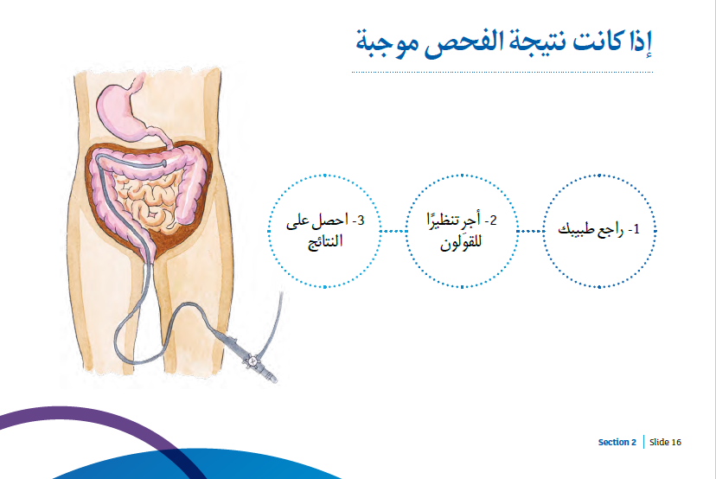
Notes:
After a positive test result, it is important to see your doctor as soon as possible so you can
receive a referral for another test, usually a colonoscopy.
•• The aim of a colonoscopy is to look inside the bowel and find out why you have blood in
your bowel movement.
•• During a colonoscopy a doctor inserts a tiny camera into the rectum to look for polyps or
cancerous growths.
•• You will receive some sedation for the procedure so you won’t feel any pain.
•• The day before the colonoscopy you will need to have a special drink to help empty your
bowel. This will allow the camera a clear view of your bowel. You will need to be near a
toilet all day.
Results
There are a number of possible things that a colonoscopy might find.
•• Nothing (clear) – No polyps or cancer. You should do the home test kit again in around 4
years’ time. A kit will be sent to you by the National Bowel Cancer Screening Program.
•• Polyps – The doctor will usually remove them when doing the colonoscopy. You will likely
need another colonoscopy in 2-5 years.
•• Cancer – May need surgery or other treatment (to be determined by a doctor).
If found early, the chance of successful treatment is very high.
•• Other conditions – The colonoscopy may find other bowel conditions.
Your doctor will follow these up with you.

Slide 18
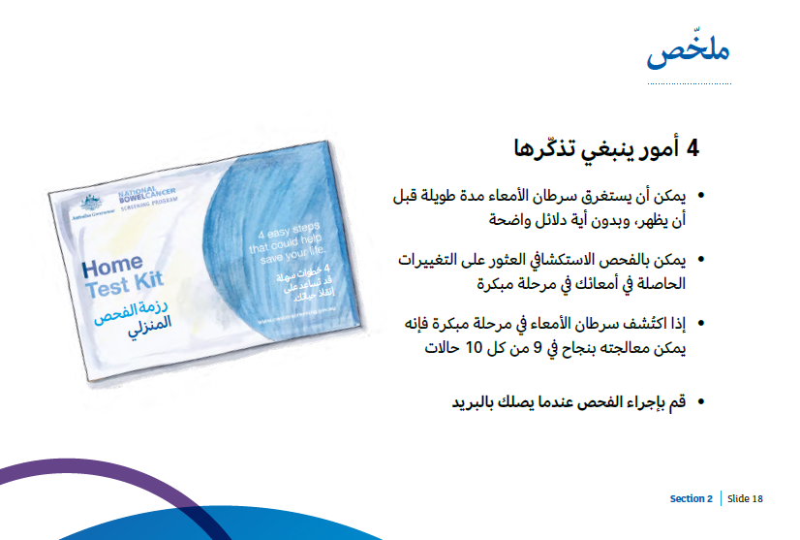
https://www.health.gov.au/resources/videos/using-the-bowel-screening-home-test-kit-arabic
Notes:
So what are the important take home messages we have learnt today?
1. Bowel can cancer develop over a long period, without any obvious
signs.
2. A screening test can detect changes in your bowel early.
3. If found early, 9 out of 10 bowel cancers can be successfully treated.
4. Do the test when it comes in the post.

Slide 19

Notes:
•• Visit the Program website at www.cancerscreening.gov.au/bowel.
•• Find out when your test will be sent (based on your date of birth) by visiting
www.cancerscreening.gov.au/eligibility.
•• Call the Program Info Line on 1800 118 868, where you can:
-- Check your eligibility for a free kit – confirm the Program has your correct
details and find out when your next kit is coming out.
-- Order a new kit (for people who have received a kit in the last 12 months
but lost or damaged it).
•• If you need help in your language call the Translating and Interpreting
Service on 13 14 50.
•• You can access a range of translated materials in 22 languages by visiting
www.cancerscreening.gov.au/translations (including test kit instructions,
an information booklet and invitation/results letters).

